Slide 1

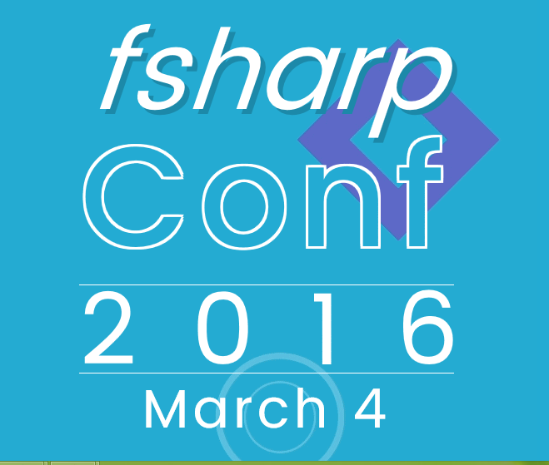


F# @ fsharpConf
Don Syme, @dsyme @tomaspetricek
Microsoft Research + F# Community Contributor

Slide 2
TL;DR
F# is open, cross-platform, neutral, independent
The F# Compiler Service powers many other tools
F# 4.0 now complete! On to F# vNext!
Debian packages, Docker containers and more for Linux
The F# language is accepting contributions
The F# community is very “self-empowered”
fsharp.org
The Visual F# Tools are Microsoft’s professional tools for Windows and Azure
Xamarin provide F# tools Android and iOS

